Slide 1

UiPath REFramework
Advocating for the Adoption of UiPath REFramework
Feb 6, 2025
Brooks, Ellis, Jordan, Zack
Notes:
Pass to Ellis

Slide 2




Meet the Team
Brooks Charlton
Ellis Hartley
Jordan Kohout
Zack Waterson

Slide 3
Overview
Introduction to UiPath REFramework
Benefits of UiPath REFramework
Real-World Examples
A brief intro to the purpose of the REFramework.
Advantages of the REFramework and why we use it.
Success stories and case studies of businesses that have benefited from using REFramework.
Simplified Automations
Support and Community
Conclusion and Call to Action
How REFramework makes automation processes smoother and more manageable.
Availability of resources, training, and a community involvement for users.
Summarizing key points and encouraging the adoption of UiPath REFramework.
Notes:
Advocating for the Adoption of UiPath ReFramework
Key Points for a PowerPoint Presentation
Introduction to UiPath ReFramework: Explain what it is and its purpose in simple terms. – Captain Ellis Hartley
Will create a timeline/contents slide and intro slide
Benefits of UiPath ReFramework: Highlight advantages such as ease of use, reliability, and efficiency. – Jordan Kohout
Real-World Examples: Share success stories and case studies of businesses that have benefited from using ReFramework. – Brooks Charlton
Simplified Automations: Describe how ReFramework makes automation processes smoother and more manageable. – Zack Waterson
Support and Community: Emphasize the availability of resources, training, and a supportive community for users. – Ellis
Conclusion and Call to Action: Summarize key points and encourage the adoption of UiPath ReFramework. – Jordan

Slide 4
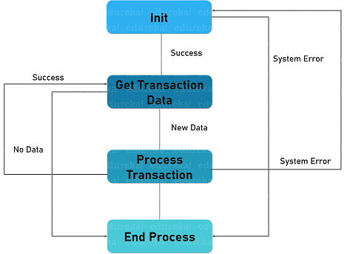
Introduction to the REFramework
The Robotic Enterprise Framework (REFramework) provides a structured approach to building scalable and reliable automation workflows.
Simplified workflow example
Organizes workflows using "States" and state machines to define stages and manage transitions.
Provides a structured approach with distinct stages like Initialization, Process, and Error Handling.
Ensures consistency and reusability by modularizing components for easier maintenance.
Enhances error handling, logging, and scalability with dedicated states for retries and recovery.
Notes:
Pass to Jordan
Key Points for a PowerPoint Presentation
Introduction to UiPath ReFramework: Explain what it is and its purpose in simple terms. – Captain Ellis Hartley
Will create a timeline/contents slide and intro slide
Benefits of UiPath ReFramework: Highlight advantages such as ease of use, reliability, and efficiency. – Jordan Kohout
Real-World Examples: Share success stories and case studies of businesses that have benefited from using ReFramework. – Brooks Charlton
Simplified Automations: Describe how ReFramework makes automation processes smoother and more manageable. – Zack Waterson
Support and Community: Emphasize the availability of resources, training, and a supportive community for users. – Ellis
Conclusion and Call to Action: Summarize key points and encourage the adoption of UiPath ReFramework. – Jordan

Slide 5
Benefits of Implementing the REFramework
Reliable
Scalability
Reliability
Maintainability
Customization
Reusability
Scale
Maintain
REFramework
Reuse
Customize
Notes:
Advocating for the Adoption of UiPath ReFramework
Key Points for a PowerPoint Presentation
Introduction to UiPath ReFramework: Explain what it is and its purpose in simple terms. – Captain Ellis Hartley
Will create a timeline/contents slide and intro slide
Benefits of UiPath ReFramework: Highlight advantages such as ease of use, reliability, and efficiency. – Jordan Kohout
Real-World Examples: Share success stories and case studies of businesses that have benefited from using ReFramework. – Brooks Charlton
Simplified Automations: Describe how ReFramework makes automation processes smoother and more manageable. – Zack Waterson
Support and Community: Emphasize the availability of resources, training, and a supportive community for users. – Ellis
Conclusion and Call to Action: Summarize key points and encourage the adoption of UiPath ReFramework. – Jordan

Slide 6

Scalability
UiPath REFramework
Scale up or down to meet your business needs
Handle large-scale automation projects out-of-the-box
Easy integration with the UiPath Orchestrator allows for seamless scalability
Notes:
Advocating for the Adoption of UiPath ReFramework
Key Points for a PowerPoint Presentation
Introduction to UiPath ReFramework: Explain what it is and its purpose in simple terms. – Captain Ellis Hartley
Will create a timeline/contents slide and intro slide
Benefits of UiPath REFramework: Highlight advantages such as ease of use, reliability, and efficiency. – Jordan Kohout
Real-World Examples: Share success stories and case studies of businesses that have benefited from using ReFramework. – Brooks Charlton
Simplified Automations: Describe how ReFramework makes automation processes smoother and more manageable. – Zack Waterson
Support and Community: Emphasize the availability of resources, training, and a supportive community for users. – Ellis
Conclusion and Call to Action: Summarize key points and encourage the adoption of UiPath ReFramework. – Jordan

Slide 7

Reliability
UiPath REFramework
Out-of-the-box error and exception handling for system and business rule exceptions
Retry failed transaction runs automatically via UiPath Orchestrator
Built-in Robust Error and Exception Handling
Notes:
Advocating for the Adoption of UiPath ReFramework
Key Points for a PowerPoint Presentation
Introduction to UiPath ReFramework: Explain what it is and its purpose in simple terms. – Captain Ellis Hartley
Will create a timeline/contents slide and intro slide
Benefits of UiPath REFramework: Highlight advantages such as ease of use, reliability, and efficiency. – Jordan Kohout
Real-World Examples: Share success stories and case studies of businesses that have benefited from using ReFramework. – Brooks Charlton
Simplified Automations: Describe how ReFramework makes automation processes smoother and more manageable. – Zack Waterson
Support and Community: Emphasize the availability of resources, training, and a supportive community for users. – Ellis
Conclusion and Call to Action: Summarize key points and encourage the adoption of UiPath ReFramework. – Jordan

Slide 8
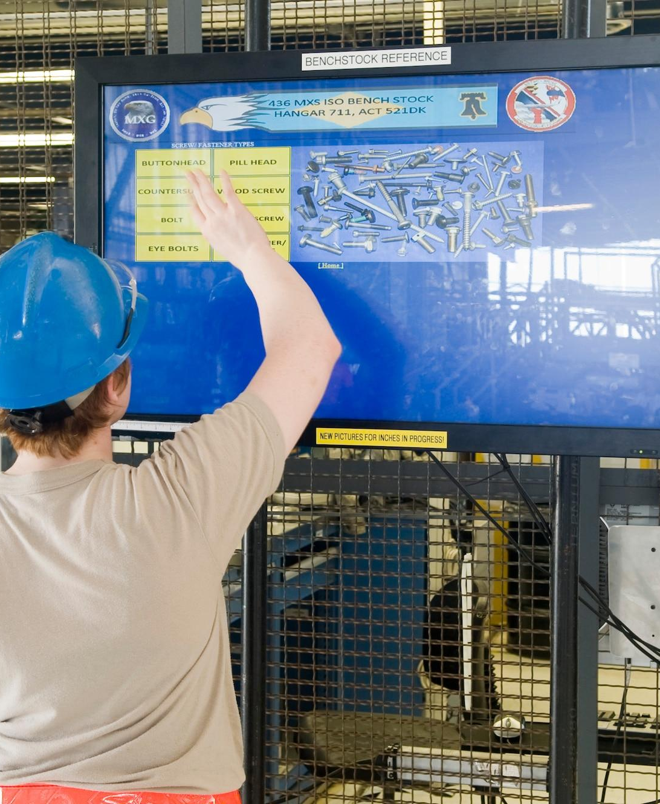
UiPath REFramework
Maintainability
Push quick fixes to adjust on the fly
Notes:
Advocating for the Adoption of UiPath ReFramework
Key Points for a PowerPoint Presentation
Introduction to UiPath ReFramework: Explain what it is and its purpose in simple terms. – Captain Ellis Hartley
Will create a timeline/contents slide and intro slide
Benefits of UiPath REFramework: Highlight advantages such as ease of use, reliability, and efficiency. – Jordan Kohout
Real-World Examples: Share success stories and case studies of businesses that have benefited from using ReFramework. – Brooks Charlton
Simplified Automations: Describe how ReFramework makes automation processes smoother and more manageable. – Zack Waterson
Support and Community: Emphasize the availability of resources, training, and a supportive community for users. – Ellis
Conclusion and Call to Action: Summarize key points and encourage the adoption of UiPath ReFramework. – Jordan

Slide 9

Customization
UiPath REFramework
Process multiple datatypes
Flexible enough to handle various types of data from multiple endpoints
Process Excel data, Lists, and data from UiPath Queues
Notes:
Advocating for the Adoption of UiPath ReFramework
Key Points for a PowerPoint Presentation
Introduction to UiPath ReFramework: Explain what it is and its purpose in simple terms. – Captain Ellis Hartley
Will create a timeline/contents slide and intro slide
Benefits of UiPath REFramework: Highlight advantages such as ease of use, reliability, and efficiency. – Jordan Kohout
Real-World Examples: Share success stories and case studies of businesses that have benefited from using ReFramework. – Brooks Charlton
Simplified Automations: Describe how ReFramework makes automation processes smoother and more manageable. – Zack Waterson
Support and Community: Emphasize the availability of resources, training, and a supportive community for users. – Ellis
Conclusion and Call to Action: Summarize key points and encourage the adoption of UiPath ReFramework. – Jordan

Slide 10

Reusability
UiPath REFramework
Reutilization across other projects
Intuitive structure, out-of-the-box components can be copied and utilized in other projects
Quickly and seamlessly switch data-types and endpoints within the same project
Notes:
Pass to Zack
Key Points for a PowerPoint Presentation
Introduction to UiPath ReFramework: Explain what it is and its purpose in simple terms. – Captain Ellis Hartley
Will create a timeline/contents slide and intro slide
Benefits of UiPath REFramework: Highlight advantages such as ease of use, reliability, and efficiency. – Jordan Kohout
Real-World Examples: Share success stories and case studies of businesses that have benefited from using ReFramework. – Brooks Charlton
Simplified Automations: Describe how ReFramework makes automation processes smoother and more manageable. – Zack Waterson
Support and Community: Emphasize the availability of resources, training, and a supportive community for users. – Ellis
Conclusion and Call to Action: Summarize key points and encourage the adoption of UiPath ReFramework. – Jordan

Slide 11
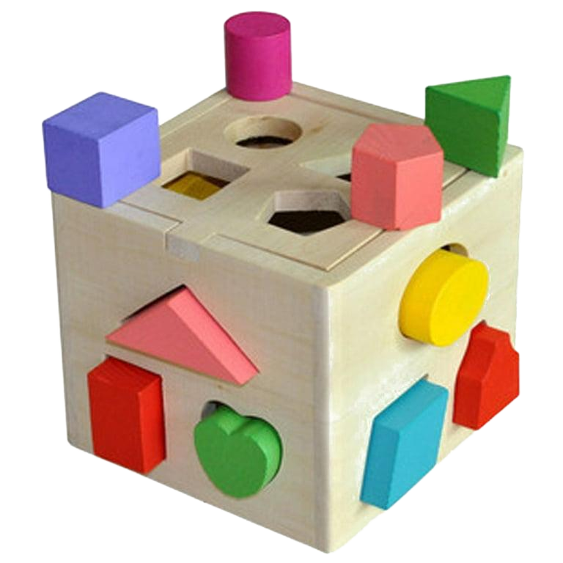
Simplified Automations
REFramework speeds up and simplifies Automation project implementations.
Provides a standardized project structure, making errors in implementation less likely to occur and easier to fix.
Includes necessary workflows and error handling so developers do not need to start from scratch.
Integrates seamlessly with Orchestrator queues.
Built in logging helps to monitor the automation and aid in debugging.
Notes:
Advocating for the Adoption of UiPath ReFramework
Key Points for a PowerPoint Presentation
Introduction to UiPath ReFramework: Explain what it is and its purpose in simple terms. – Captain Ellis Hartley
Will create a timeline/contents slide and intro slide
Benefits of UiPath REFramework: Highlight advantages such as ease of use, reliability, and efficiency. – Jordan Kohout
Real-World Examples: Share success stories and case studies of businesses that have benefited from using ReFramework. – Brooks Charlton
Simplified Automations: Describe how ReFramework makes automation processes smoother and more manageable. – Zack Waterson
Support and Community: Emphasize the availability of resources, training, and a supportive community for users. – Ellis
Conclusion and Call to Action: Summarize key points and encourage the adoption of UiPath ReFramework. – Jordan

Slide 12

Simplified Automations
REFramework allows for settings and parameter changes in a config file without changing the code.
Includes activities to initialize all programs utilized by the automation, and activities to close and restart the applications in case of an error.
Due to the standardized project structure, it is easier for another developer to pick it up in the future, if necessary.
Notes:
Pass to Brooks
Key Points for a PowerPoint Presentation
Introduction to UiPath ReFramework: Explain what it is and its purpose in simple terms. – Captain Ellis Hartley
Will create a timeline/contents slide and intro slide
Benefits of UiPath REFramework: Highlight advantages such as ease of use, reliability, and efficiency. – Jordan Kohout
Real-World Examples: Share success stories and case studies of businesses that have benefited from using ReFramework. – Brooks Charlton
Simplified Automations: Describe how ReFramework makes automation processes smoother and more manageable. – Zack Waterson
Support and Community: Emphasize the availability of resources, training, and a supportive community for users. – Ellis
Conclusion and Call to Action: Summarize key points and encourage the adoption of UiPath ReFramework. – Jordan

Slide 13
Business Case: Automating Employee Onboarding
A large company hires hundreds of new employees every month. The HR department currently manually processes onboarding tasks for each new hire such as:
Creating and setting up user accounts
Sending welcome emails with benefit packets, necessary training needing to be completed, and other needed company/job information
Updating their HCM solution and other internal systems
The process is time consuming and repetitive and is prone to delays
The company is looking to automate the entire employee onboarding process using UiPath’s ReFramework to ensure accuracy, speed, and efficiency
Notes:
Advocating for the Adoption of UiPath ReFramework
Key Points for a PowerPoint Presentation
Introduction to UiPath ReFramework: Explain what it is and its purpose in simple terms. – Captain Ellis Hartley
Will create a timeline/contents slide and intro slide
Benefits of UiPath ReFramework: Highlight advantages such as ease of use, reliability, and efficiency. – Jordan Kohout
Real-World Examples: Share success stories and case studies of businesses that have benefited from using ReFramework. – Brooks Charlton
Simplified Automations: Describe how ReFramework makes automation processes smoother and more manageable. – Zack Waterson
Support and Community: Emphasize the availability of resources, training, and a supportive community for users. – Ellis
Conclusion and Call to Action: Summarize key points and encourage the adoption of UiPath ReFramework. – Jordan

Slide 14
Business Case: Initialization
Load configuration files (HR credentials, email templates, benefit packets, account creation information)
Establish connections to the HCM solution and other internal systems (Microsoft 365, directory, company applications)
Retrieve new hire data from Recruiting team
Notes:
Advocating for the Adoption of UiPath ReFramework
Key Points for a PowerPoint Presentation
Introduction to UiPath ReFramework: Explain what it is and its purpose in simple terms. – Captain Ellis Hartley
Will create a timeline/contents slide and intro slide
Benefits of UiPath ReFramework: Highlight advantages such as ease of use, reliability, and efficiency. – Jordan Kohout
Real-World Examples: Share success stories and case studies of businesses that have benefited from using ReFramework. – Brooks Charlton
Simplified Automations: Describe how ReFramework makes automation processes smoother and more manageable. – Zack Waterson
Support and Community: Emphasize the availability of resources, training, and a supportive community for users. – Ellis
Conclusion and Call to Action: Summarize key points and encourage the adoption of UiPath ReFramework. – Jordan

Slide 15
Business Case: Get Transaction Data
Read each new hire’s information personal details, department, job title, start date, manager)
Add employee data to the queue for internal processing
Notes:
Advocating for the Adoption of UiPath ReFramework
Key Points for a PowerPoint Presentation
Introduction to UiPath ReFramework: Explain what it is and its purpose in simple terms. – Captain Ellis Hartley
Will create a timeline/contents slide and intro slide
Benefits of UiPath ReFramework: Highlight advantages such as ease of use, reliability, and efficiency. – Jordan Kohout
Real-World Examples: Share success stories and case studies of businesses that have benefited from using ReFramework. – Brooks Charlton
Simplified Automations: Describe how ReFramework makes automation processes smoother and more manageable. – Zack Waterson
Support and Community: Emphasize the availability of resources, training, and a supportive community for users. – Ellis
Conclusion and Call to Action: Summarize key points and encourage the adoption of UiPath ReFramework. – Jordan

Slide 16
Business Case: Process Transaction
Create user accounts in the company’s HCM system, directory, role-dependent internal applications, and Microsoft 365
Assign system access based on applicable role and department
Send welcome email with login credentials set up, onboarding information, and applicable training documents
Schedule orientation session by adding new hires to meeting invite
Notes:
Advocating for the Adoption of UiPath ReFramework
Key Points for a PowerPoint Presentation
Introduction to UiPath ReFramework: Explain what it is and its purpose in simple terms. – Captain Ellis Hartley
Will create a timeline/contents slide and intro slide
Benefits of UiPath ReFramework: Highlight advantages such as ease of use, reliability, and efficiency. – Jordan Kohout
Real-World Examples: Share success stories and case studies of businesses that have benefited from using ReFramework. – Brooks Charlton
Simplified Automations: Describe how ReFramework makes automation processes smoother and more manageable. – Zack Waterson
Support and Community: Emphasize the availability of resources, training, and a supportive community for users. – Ellis
Conclusion and Call to Action: Summarize key points and encourage the adoption of UiPath ReFramework. – Jordan

Slide 17
Business Case: End Process
Log successful onboarding in the HCM solution
If any errors occurred (system issues, missing data, incomplete data), retry or notify HR
Notes:
Pass back to Ellis
Key Points for a PowerPoint Presentation
Introduction to UiPath ReFramework: Explain what it is and its purpose in simple terms. – Captain Ellis Hartley
Will create a timeline/contents slide and intro slide
Benefits of UiPath ReFramework: Highlight advantages such as ease of use, reliability, and efficiency. – Jordan Kohout
Real-World Examples: Share success stories and case studies of businesses that have benefited from using ReFramework. – Brooks Charlton
Simplified Automations: Describe how ReFramework makes automation processes smoother and more manageable. – Zack Waterson
Support and Community: Emphasize the availability of resources, training, and a supportive community for users. – Ellis
Conclusion and Call to Action: Summarize key points and encourage the adoption of UiPath ReFramework. – Jordan

Slide 18


Support and Community
UiPath provides a large number of resources and tools to support developers in using the REFramework, including a fully-integrated training platform, detailed documentation, and a community forum with expert guidance from the UiPath Team. .
Documentation
UiPath
REFramework
Notes:
Pass to Jordan

Slide 19




Conclusion
The REFramework provides numerous benefits to developers and stakeholders:
Consistency and reusability
Robust, built-in error handling
Flexible design for processing multiple data types from various sources
Track successes and failures via transactional model
Easy configuration allows for switching to linear models too!
Before REFramework
After REFramework
Stakeholder receiving yet another message about failed automations, losing critical business data
The same stakeholder after switching to REFramework. Critical business data delivered!

